Slide 1
Scripture Study: Listening to God’s Word
The Unity of Scripture - Part 2
“The New hidden in the Old –
the Old unveiled in the New”
1

Slide 2
Scripture Study: Listening to God’s Word
The New hidden in the Old and
the Old unveiled in the New
A very common expression, dating back to
the early beginnings of the Church, states that the New Testament lies hidden in the Old and the Old Testament is unveiled in the New – the two shed light on each other.
The Old Testament prepared the way for the coming of the Messiah, the Lord Jesus Christ who came not only to redeem the people of Israel but the whole world as well.
2

Slide 3
Scripture Study: Listening to God’s Word
“All Scripture describes the coming of
the Lord. The New Testament is hidden in the Old; the Old Testament is brought to light in the New.”
“Those who are unspiritual have always failed to see this hidden meaning. Yet even before Christ those who were spiritual could find the Words of God hidden in the words of the prophets, and so through this understanding could be set free.”
– St. Augustine, bishop of Hippo (354-430 AD)
3

Slide 4
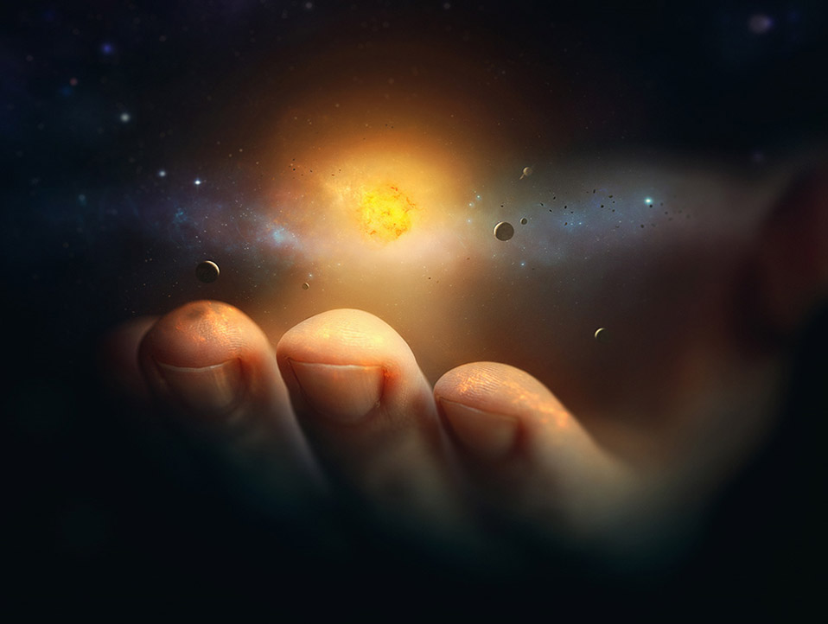
A Scripture study exercise
Read and compare the following two passages:
Genesis 1:1-3,26
and John 1:1-3
How might these passages be related to one another?
4

Slide 5
In the beginning…
"In the beginning, God created the heavens and the earth… And the Spirit of God was hovering over the face of the waters (Genesis 1:1,3)... Then God said, “Let us make man in our image, after our likeness (Genesis 1:26).
In the beginning was the Word, and the Word was with God, and the Word was God. He was in the beginning with God. All things were made through him, and without him was not any thing made that was made (John 1:1-3).”
5

Slide 6
Compare the verses in Genesis 1:1-3 with the verses in John 1:1-3. What similarities do you see? And what differences do you see?
God’s word is a spoken word – when God speaks his word has creative and dynamic power to bring about a change and transformation. His word can even create something out of nothing.
6

Slide 7
Why does John begin his Gospel account with the same three words recorded in the book of Genesis, chapter 1 (Genesis 1:1 and John 1:1)? Is John comparing the beginning of creation with the coming of Jesus, the Son of God, who became a man of flesh and blood like us? Or is John saying something more – a continuity, development, or fulfillment of what began in the Old?
7

Slide 8
How does Genesis 1 shed light on John 1 and how does John 1 bring to light what is hidden in Genesis 1?
In Genesis 1:26 God speaks in the plural,
“Let us make man in our image.” How does the Gospel of John reveal what is hidden in Genesis 1:26?
Christians throughout the ages have understood this plural expression in Genesis as a veiled reference to the Trinity of the one Godhead (three persons – Father, Son, and Holy Spirit – in one God).
8

Slide 9
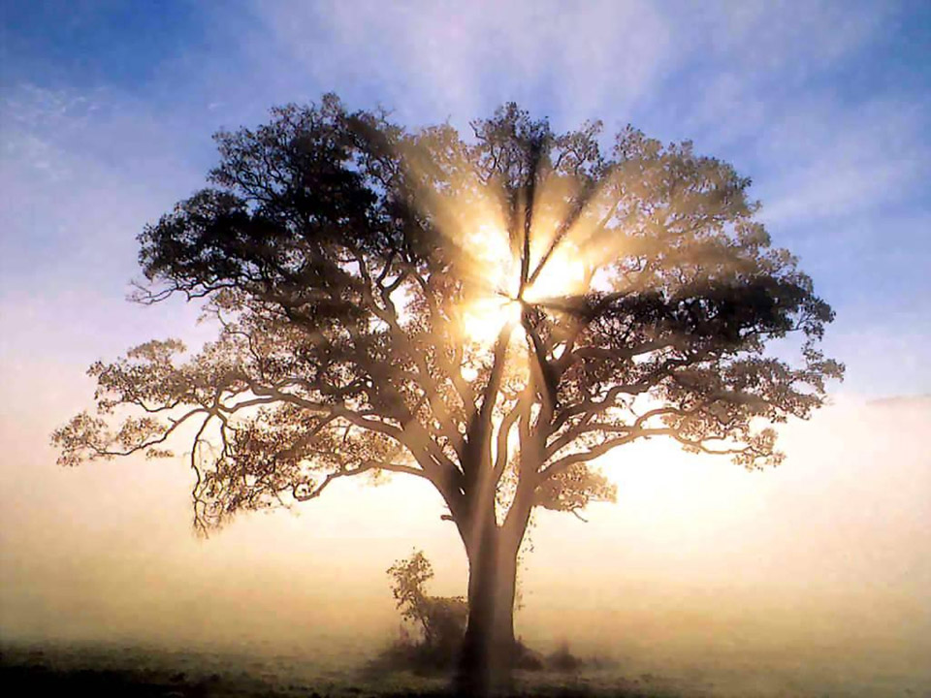
A Scripture study exercise
The Tree of Life
& the healing of the nations
9

Slide 10
Tree of Life
in the Garden of Eden
“And out of the ground the Lord God made to spring up every tree that is pleasant to the sight and good for food. The tree of life was in the midst of the garden, and the tree of the knowledge of good and evil.”
– Genesis 2:9
10

Slide 11
Tree of Life
in the New Jerusalem
“Then the angel showed me the river of the water of life… flowing from the throne of God and of the Lamb… also, on either side of the river, the tree of life with its twelve kinds of fruit, yielding its fruit each month. The leaves of the tree were for the healing of the nations.”
- Revelation 22:1-2
11

Slide 12
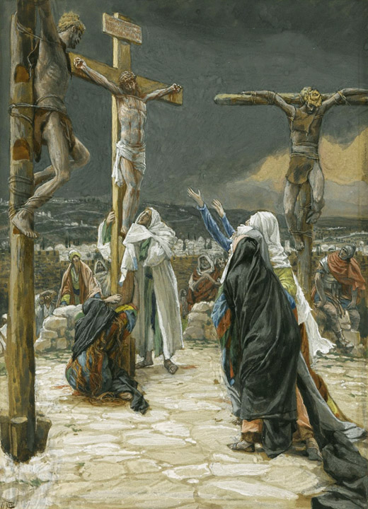
“He himself bore our sins in his body on the tree… By his wounds you have been healed.” - 2 Peter 2:24 The Cross of Christ is a Tree of Life that brings healing, and new life in Christ
12

Slide 13
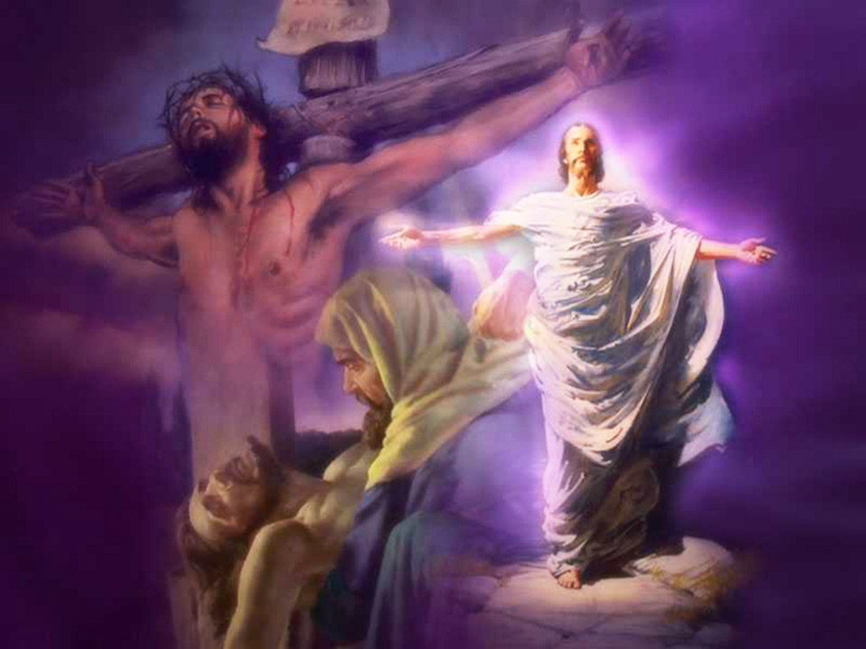
“The God of our fathers raised Jesus, whom you killed by hanging him on a tree.” - Acts 5:30
13

Slide 14
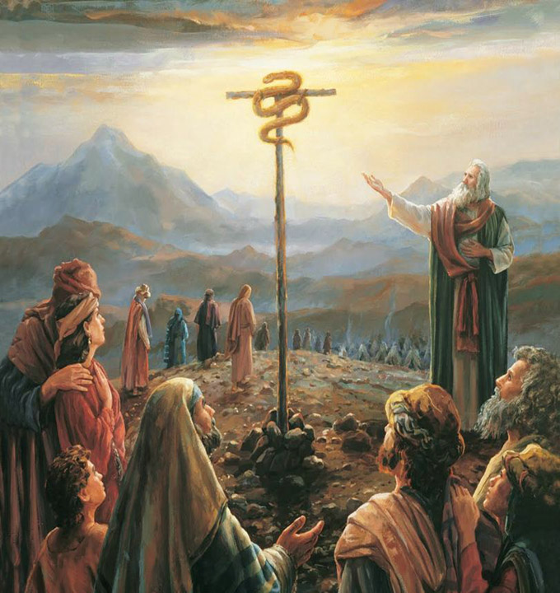
“And as Moses lifted up the serpent in the wilderness, so must the Son of man be lifted up, that whoever believes in him may have eternal life.” - John 3:14-15
14

Slide 15
Scripture Study: Listening to God’s Word
“How precious the gift of the cross, how splendid to contemplate! In the cross there is no mingling of good and evil, as in the tree of paradise: it is wholly beautiful to behold and good to taste. The fruit of this tree is not death but life, not darkness but light. This tree does not cast us out of paradise, but opens the way for our return…
By the cross death was slain and Adam was restored to life. The cross is the glory of all the apostles, the crown of the martyrs, the sanctification of the saints. By the cross we put on Christ and cast aside our former self. By the cross we, the sheep of Christ, have been gathered into one flock, destined for the sheepfold of heaven.”
– Theodore the Studite (759–826 AD)
15

Slide 16
Scripture Study: Listening to God’s Word
The Holy Spirit will give us a disciple’s ear
if we are ready to listen and eager to learn
“Morning by morning he wakens my ear to hear as those who are taught. The Lord God has opened my ear, and I was not rebellious”
- Isaiah 50:4-5
16

Slide 17
Scripture Study: Listening to God’s Word
Credits for Kairos Scripture Study Course
Illustrations by Kevin Carden, slides 1, 4
Illustration by James Tissot, slide 12
Slides edited by Don Schwager
17

