Slide 1
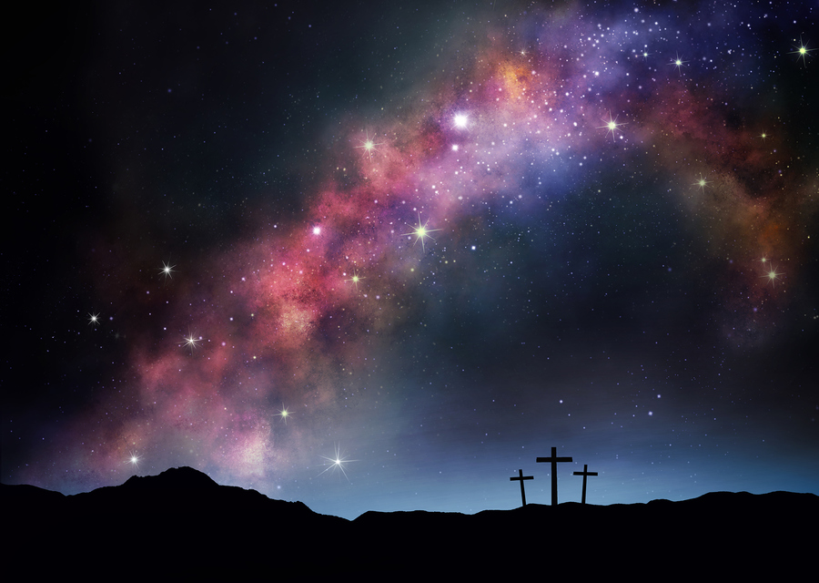
Scripture Study: Listening to God’s Word
Week 7 Scripture Study
Old Testament Types that Foreshadow Christ
and his Work of Salvation
Kairos Scripture Study Course – edited by Don Schwager 2013-2016 – see credits at end

Slide 2
Scripture Study: Listening to God’s Word
New hidden in the Old – Old unveiled in the New
A very common expression, dating back to the early beginnings of the Christian church, states that the New Testament lies hidden in the Old and the Old Testament is unveiled in the New – the two shed light on each other.
The Old Testament prepared the way for the coming of the Messiah, the Lord Jesus Christ who came not only to redeem the people of Israel but the whole world as well.

Slide 3
Scripture Study: Listening to God’s Word
“All Scripture describes the coming of the Lord.
The New Testament is hidden in the Old; the Old Testament is brought to light in the New. Those who are unspiritual have always failed to see this hidden meaning. Yet even before Christ those who were spiritual could find the Words of God hidden in the words of the prophets, and so through this understanding could be set free.”
– Augustine, bishop of Hippo (354-430 AD)

Slide 4
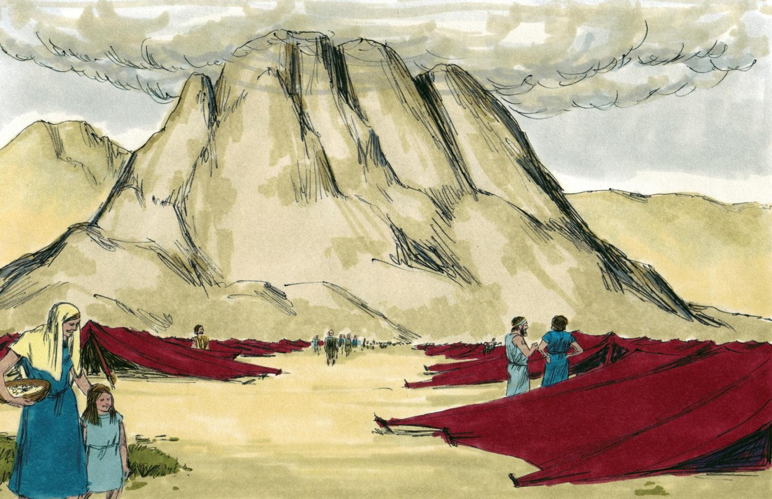
Scripture Study: Listening to God’s Word
“Patterns” or “Types” in the Scriptures

Slide 5
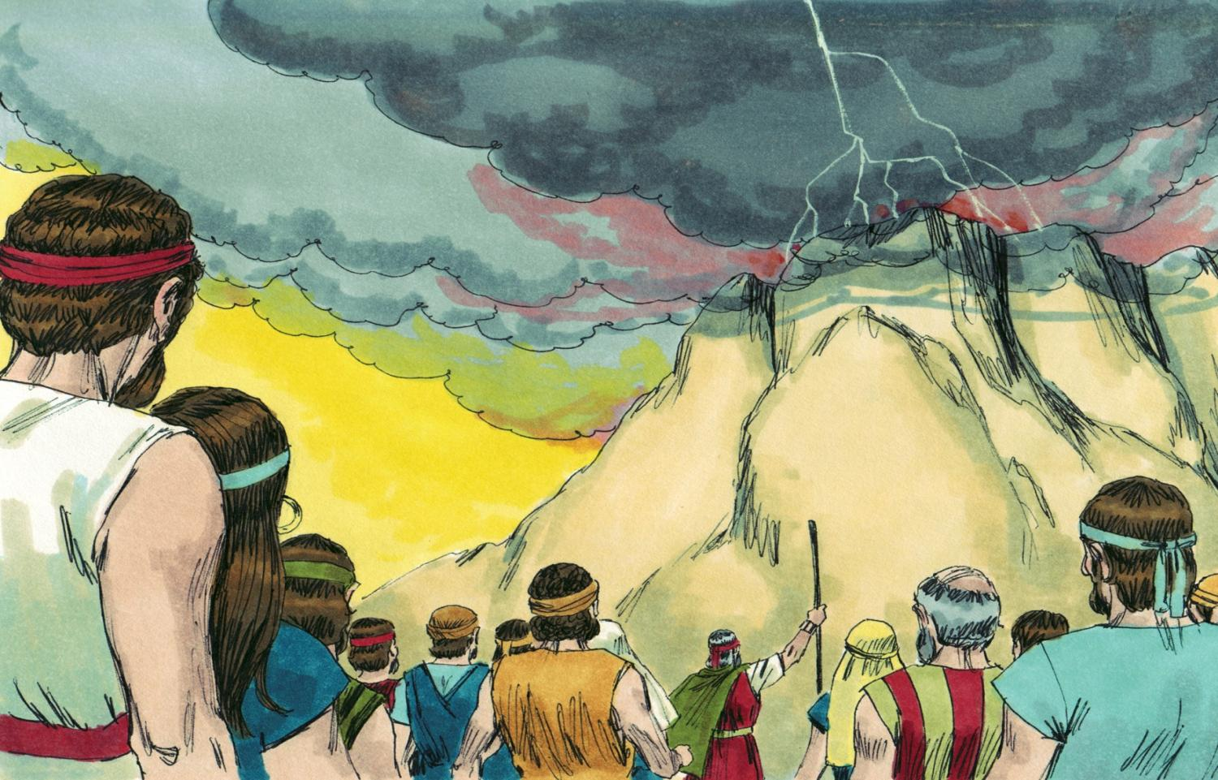
Scripture Study: Listening to God’s Word
Moses at Mount Sinai

Slide 6
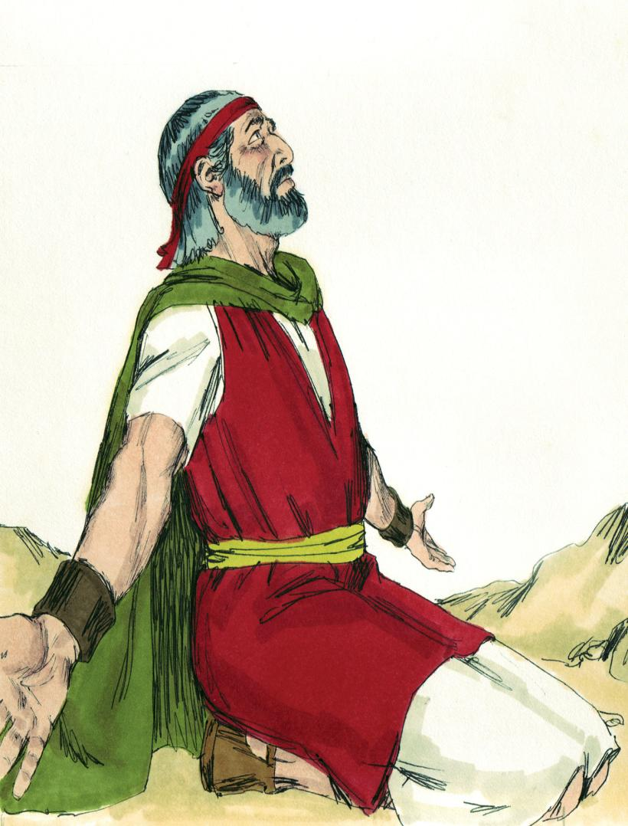
Scripture Study: Listening to God’s Word
The Lord said to Moses..
“Let them make me a sanctuary, that I may dwell in their midst. According to all that I show you concerning the pattern of the tabernacle, and of all its furniture, so you shall make it… And see that you make them after the pattern for them, which is being shown you on the mountain.”
– Exodus 25:1,8-9,40

Slide 7
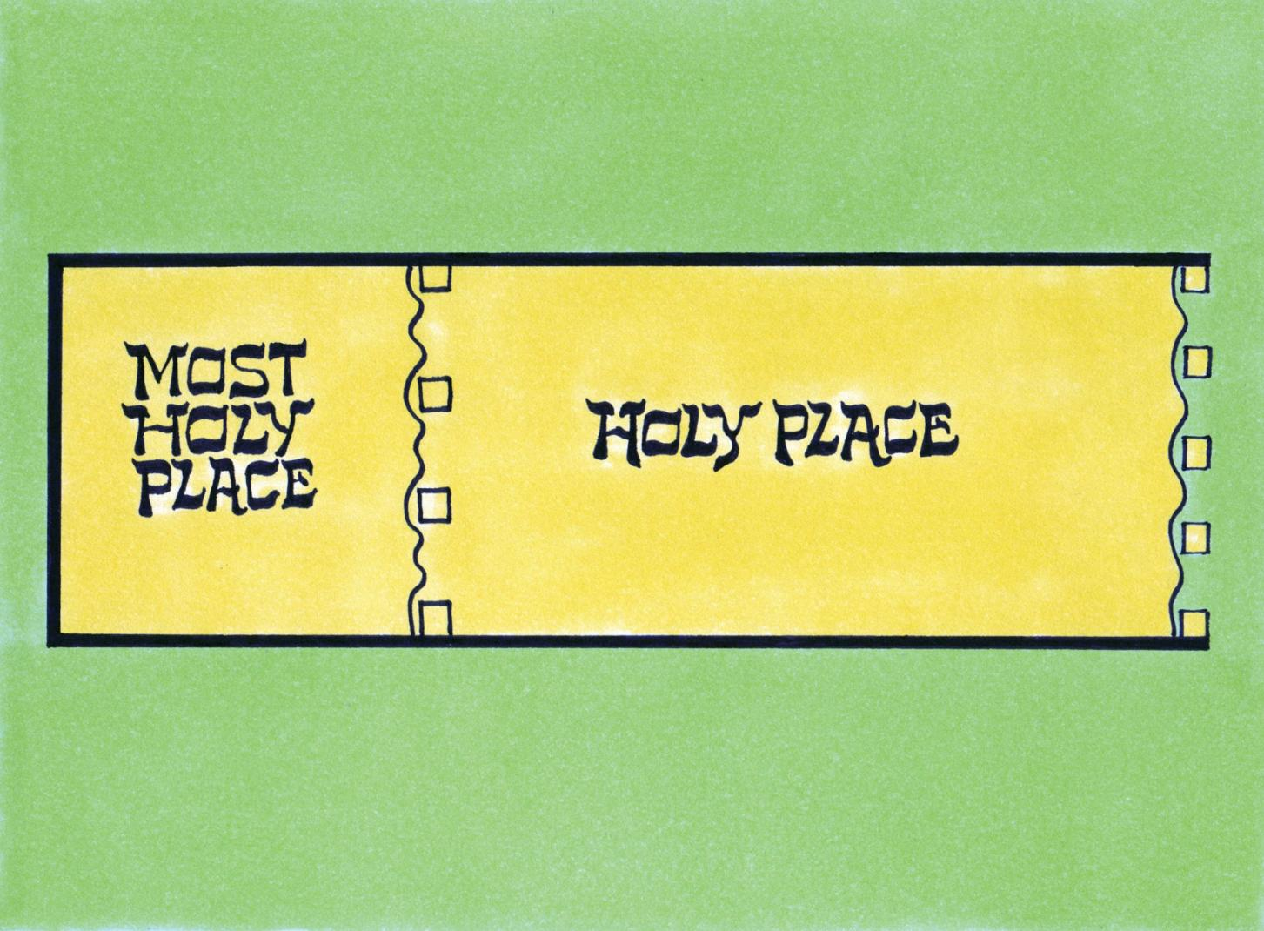
Scripture Study: Listening to God’s Word

Slide 8
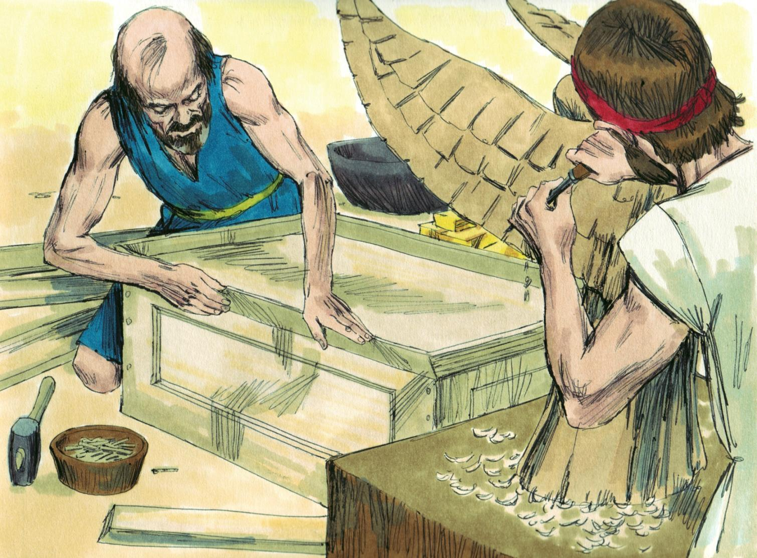
Scripture Study: Listening to God’s Word

Slide 9
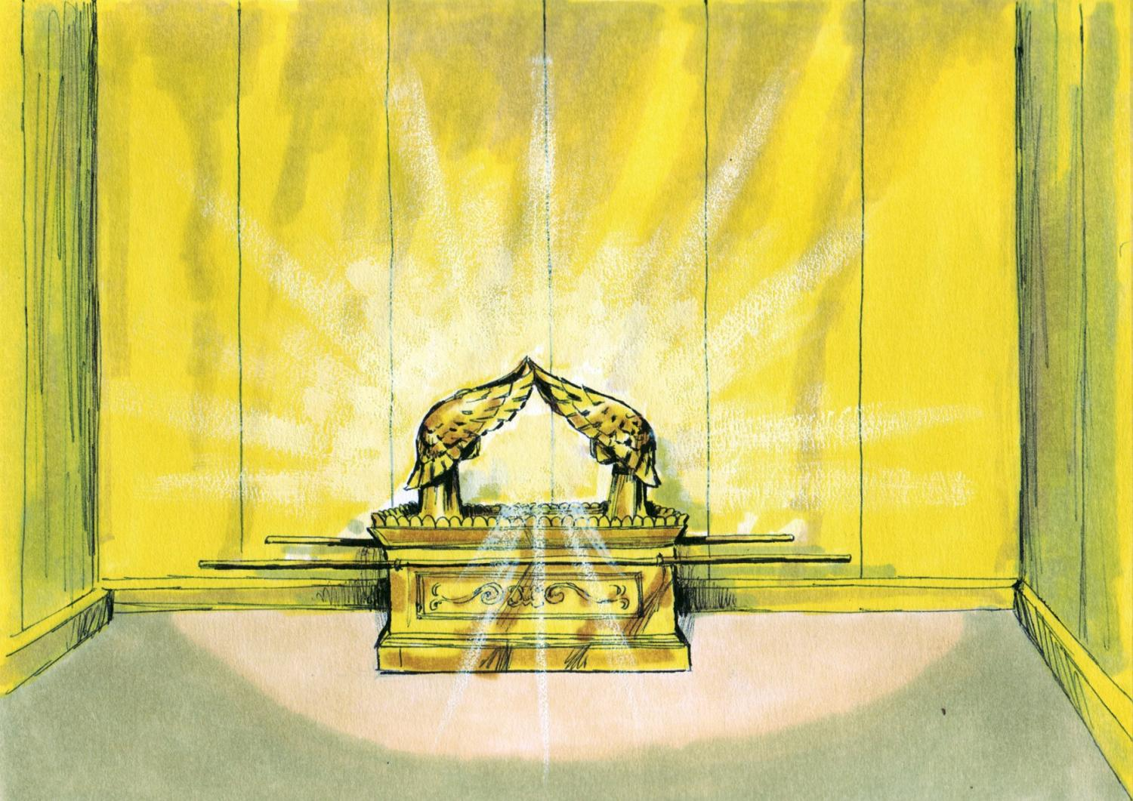
Scripture Study: Listening to God’s Word

Slide 10
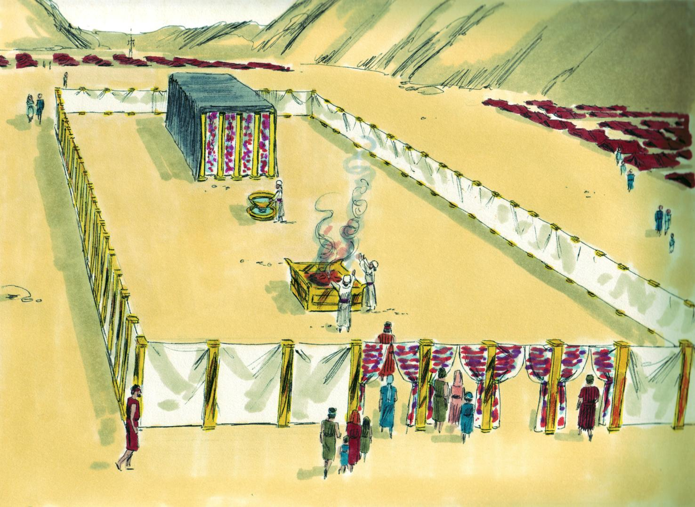
Scripture Study: Listening to God’s Word

Slide 11
Scripture Study: Listening to God’s Word
New Testament Interpretation
“They serve a copy and shadow of the heavenly sanctuary; for when Moses was about to erect the tent, he was instructed by God, saying, "See that you make everything according to the pattern which was shown you on the mountain.”
– Hebrews 8:5
“For Christ has entered, not into a sanctuary made with hands, a copy of the true one, but into heaven itself, now to appear in the presence of God on our behalf. “
– Hebrews 9:24

Slide 12
Scripture Study: Listening to God’s Word
Meaning of “pattern” and “type”
The word “pattern” in Scripture can also be translated “type”. The Greek Bible uses the word tupos to translate the Hebrew word for pattern in Exodus 25:40.
The English word type comes from the Greek word tupos. The Latin translation of type (tupos) was figura. The Old type is a figure or something that prefigures the New Testament realities.
The Old Testament realities came before the New Testament realities, but they showed something of what the New Testament realities would be like. The Old Testament realities typify the New Testament realities.

Slide 13
Scripture Study: Listening to God’s Word
New Testament Interpretation
“I want you to know, brethren, that our fathers were all under the cloud, and all passed through the sea, and all were baptized into Moses in the cloud and in the sea, and all ate the same supernatural food and all drank the same supernatural drink. For they drank from the supernatural Rock which followed them, and the Rock was Christ.”
– 1 Corinthians 10:1-4

Slide 14
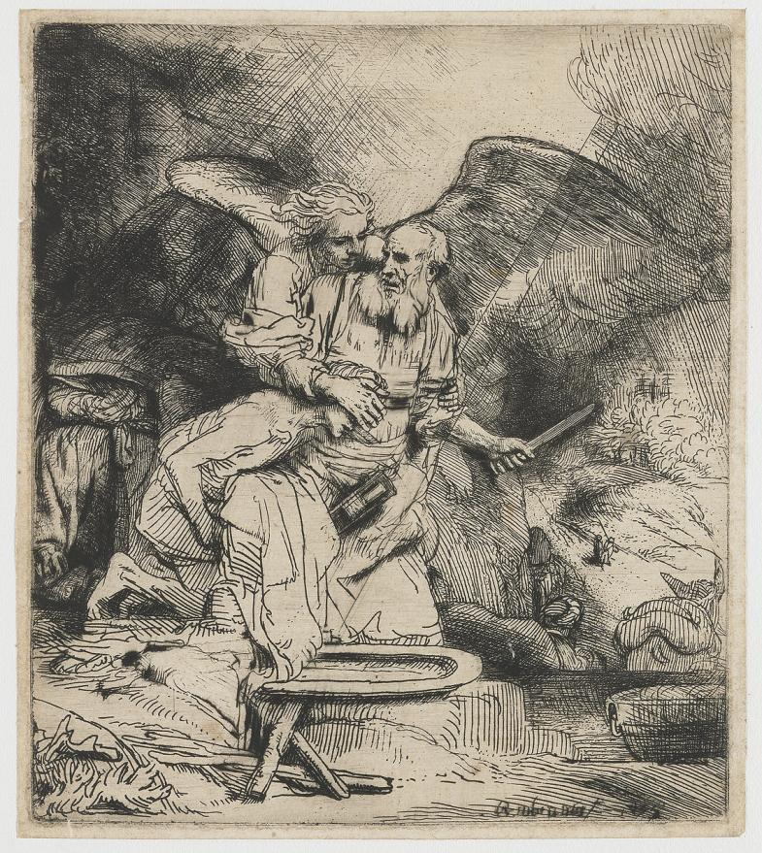
Scripture Study: Listening to God’s Word
Some Old Testament Types
that Foreshadow Christ and his Work of Salvation

Slide 15
Scripture Study: Listening to God’s Word
Old Testament Types of Christ
A “Type” is a representation or pre-figuring of something that is to come. We might think of it as a template or even a shadow (or foreshadowing) that dimly represents what is to come.
These are intentionally placed in the Scripture to describe and identify the Messiah when he came. They were designed by God to prefigure some aspect of the person of Jesus Christ. They are Old Testament “anticipations” of Christ and since they dealt with a future person (the Messiah), they were “prophetic.”

Slide 16
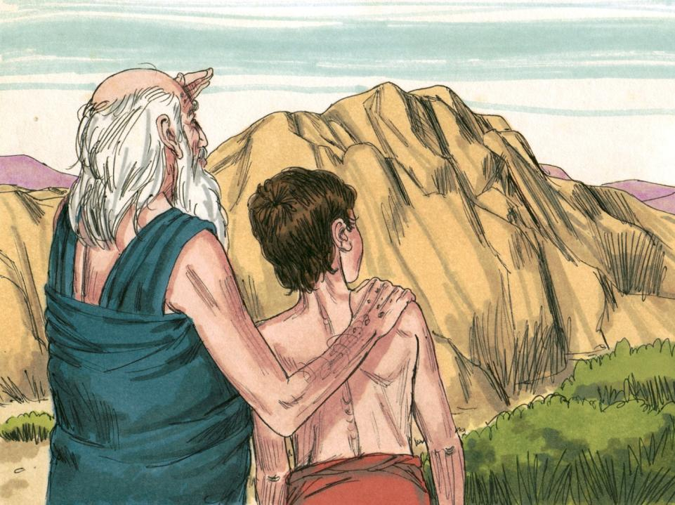
Scripture Study: Listening to God’s Word
^{Genesis 22:1} After these things God tested Abraham and said to him, “Abraham!” And he said, “Here I am.” ² He said, “Take your son, your only son Isaac, whom you love, and go to the land of Moriah, and offer him there as a burnt offering on one of the mountains of which I shall tell you.”

Slide 17
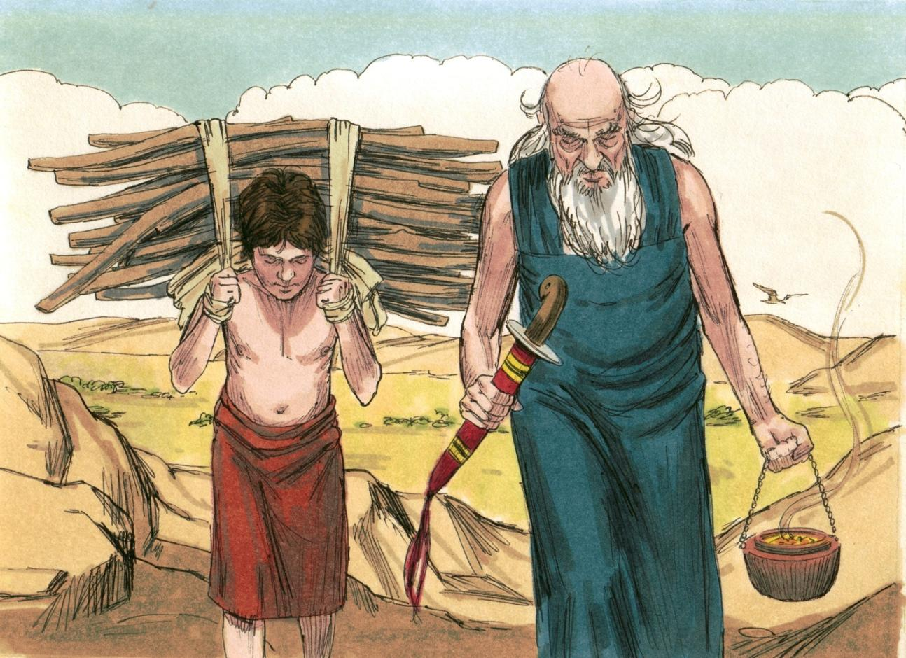
Scripture Study: Listening to God’s Word
⁶ And Abraham took the wood of the burnt offering and laid it on Isaac his son.

Slide 18
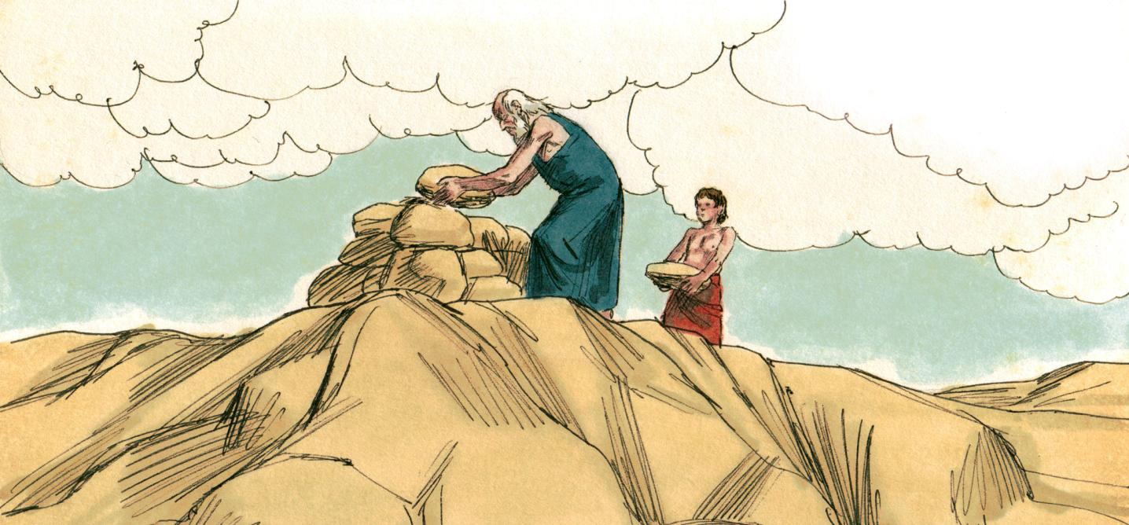
Scripture Study: Listening to God’s Word
⁷ And Isaac said to his father Abraham, “My father!” And he said, “Here I am, my son.” He said, “Behold, the fire and the wood, but where is the lamb for a burnt offering?” ⁸ Abraham said, “God will provide for himself the lamb for a burnt offering, my son.”

Slide 19
Scripture Study: Listening to God’s Word
When they came to the place of which God had told him, Abraham built an altar there, and laid the wood in order, and bound Isaac his son, and laid him on the altar, upon the wood.
Then Abraham put forth his hand, and took the knife to slay his son.
^{– Genesis 22}

Slide 20
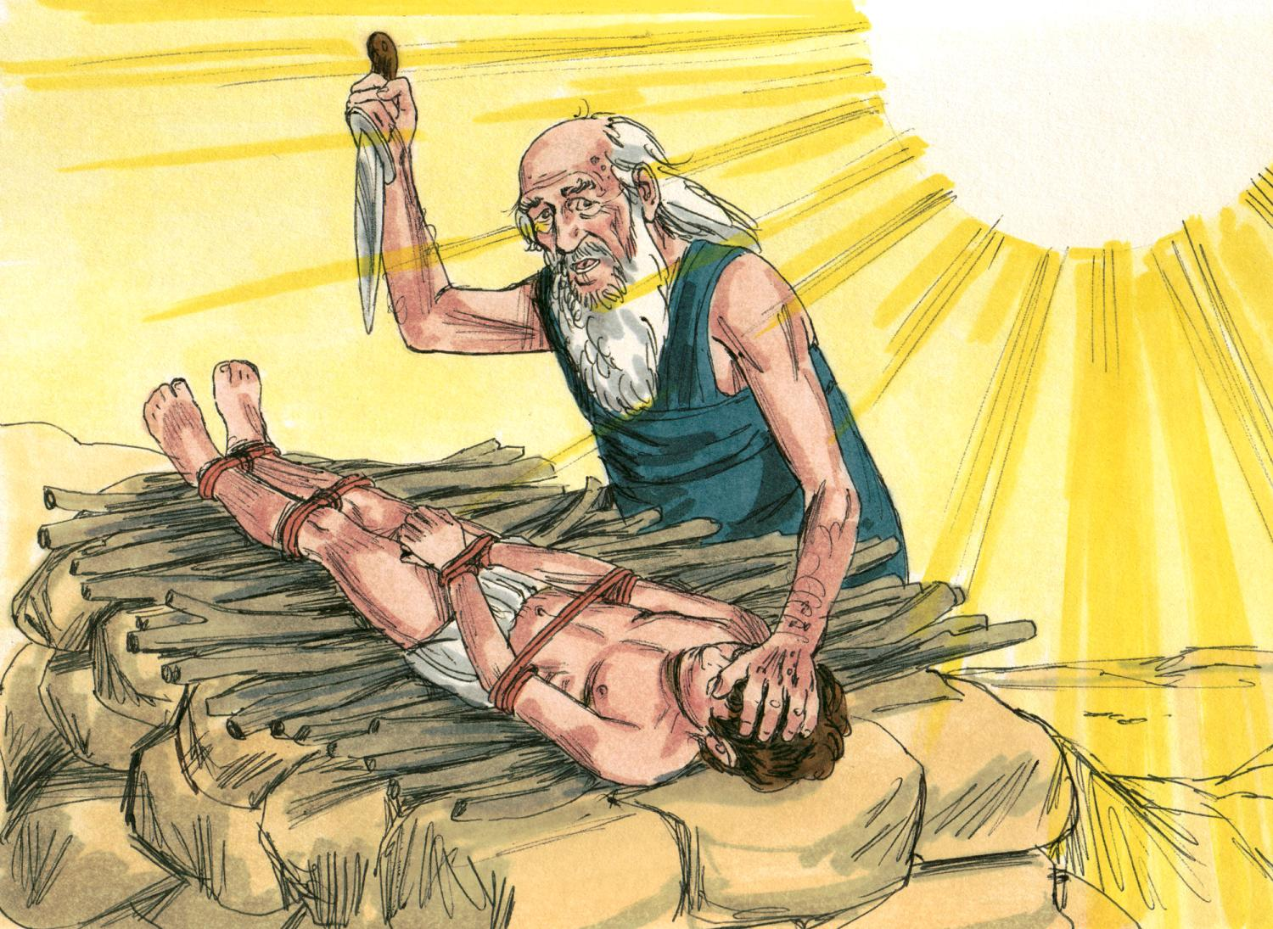
Scripture Study: Listening to God’s Word

Slide 21
Scripture Study: Listening to God’s Word
But the angel of the LORD called to him from heaven, and said, "Abraham, Abraham!" And he said, "Here am I."
He said, "Do not lay your hand on the lad or do anything to him; for now I know that you fear God, seeing you have not withheld your son, your only son, from me."
And Abraham lifted up his eyes and looked, and behold, behind him was a ram, caught in a thicket by his horns; and Abraham went and took the ram, and offered it up as a burnt offering instead of his son.
So Abraham called the name of that place The LORD will provide; as it is said to this day, "On the mount of the LORD it shall be provided.“
^{– Genesis 22}

Slide 22
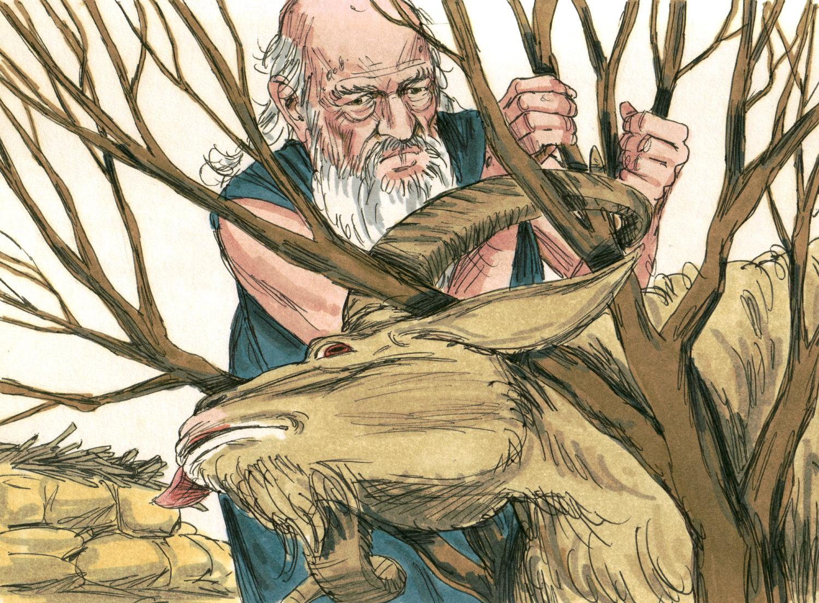
Scripture Study: Listening to God’s Word

Slide 23
Scripture Study: Listening to God’s Word
¹⁵ And the angel of the Lord called to Abraham a second time from heaven ¹⁶ and said, “By myself I have sworn, declares the Lord, because you have done this and have not withheld your son, your only son, ¹⁷ I will surely bless you, and I will surely multiply your offspring as the stars of heaven and as the sand that is on the seashore.
And your offspring shall possess the gate of his enemies, ¹⁸ and in your offspring shall all the nations of the earth be blessed, because you have obeyed my voice.”

Slide 24
Scripture Study: Listening to God’s Word
Day 3 Scripture Meditation

Slide 25
Scripture Study: Listening to God’s Word
Some “types” are people
..
And Melchizedek king of Salem brought out bread and wine: and he was the priest of the most high God. And he blessed him, and said, "Blessed be Abram to the most high God, possessor of heaven and earth, And blessed be the most high God, who has delivered your enemies into your hand". And he gave him tithe from all. — Genesis 14:18-20
Melchizedek was both a priest and king without end (Psalm 110:4 “a priest forever after the order of Melchizedek”),

Slide 26
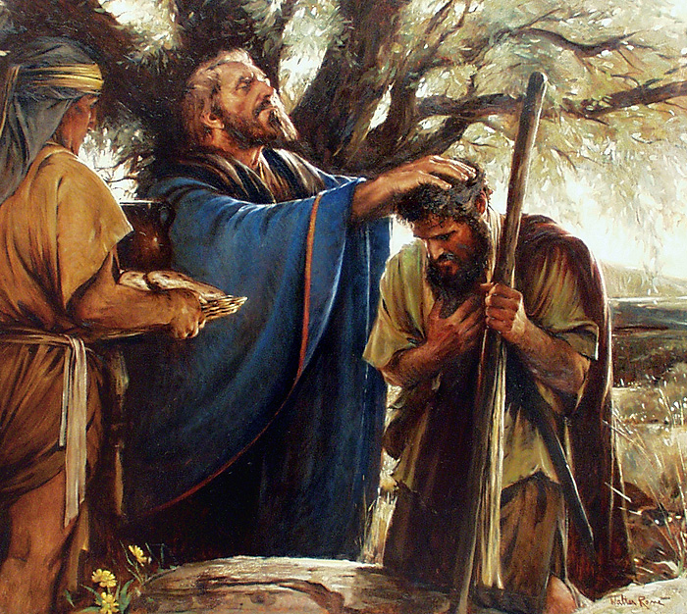
Scripture Study: Listening to God’s Word
Melchizedek was both a priest and king

Slide 27
Scripture Study: Listening to God’s Word
New Testament Interpretation
..
“Christ did not exalt himself to be made a high priest, but was appointed by him who said to him, “You are my Son, today I have begotten you";
as he says also in another place, “You are a priest for ever, after the order of Melchizedek."
- Hebrews 5:5,10

Slide 28
Scripture Study: Listening to God’s Word
Isaac a type of Christ
..
Isaac, the only begotten “son of promise” (Hebrews 11:17) whom Abraham was prepared to slay as a sacrificial offering to God (Isaac carried the wood for the sacrifice, and was bound and laid upon the wood, but was substituted by a lamb which God provided for Abraham).

Slide 29
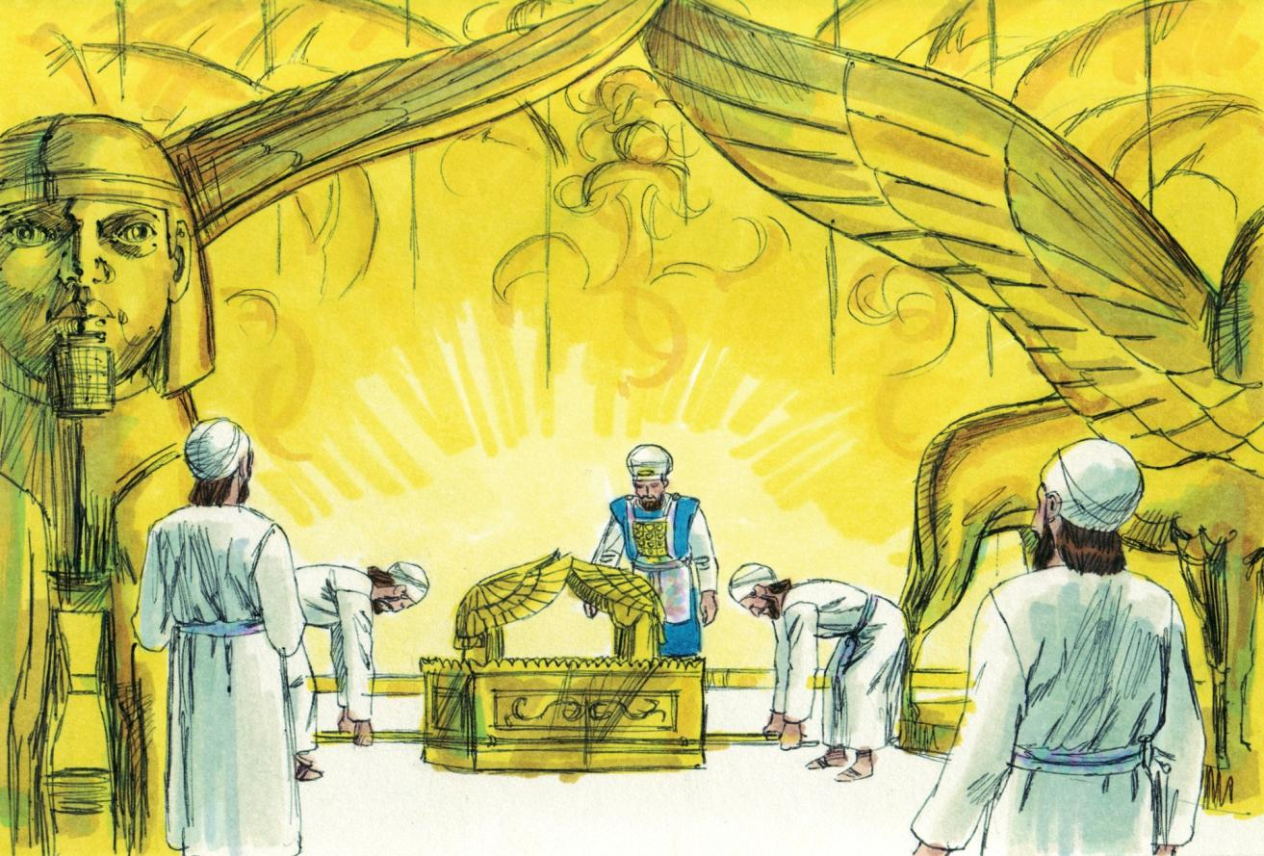
Scripture Study: Listening to God’s Word
Some “types” are things
Example of the Ark of the Covenant and the Temple

Slide 30
Scripture Study: Listening to God’s Word
The Temple in Jerusalem represented God’s dwelling with his people. The Ark of the Covenant (tabernacle) with the seat of mercy is a type of Christ.
Jesus told the Jews, “destroy this temple (referring to himself), and I will raise it in three days” (pointing to his resurrection).
“Then God's temple in heaven was opened, and the ark of his covenant was seen within his temple; and there were flashes of lightning, voices, peals of thunder, an earthquake, and heavy hail.” – Revelation 11:19

Slide 31
Scripture Study: Listening to God’s Word
Some “types” are events
..
Other Old testament types:
Passover, Day of Atonement, Feast of Unleavened Bread, Feast of Pentecost.
Each of them beautifully picture some aspect of the life and ministry of Jesus Christ hundreds of years before his Incarnation – when the Word of God became flesh and dwelt among us (John 1).

Slide 32
Scripture Study: Listening to God’s Word
Copy, Pattern, Symbol, Parable
..
Two other words, copy and pattern, are also used in a similar way in the Scriptures.
A copy or pattern gives us a sketch, draft, or outline that foreshadows or serves as a type of the reality that will be revealed in Christ when he comes.

Slide 33
Scripture Study: Listening to God’s Word
Comparison of Adam and Christ
Both Adam and Christ are called the son of God
Both entered the world in a unique way. Both entered the world sinless.
Both were appointed as God’s representative and “head” of the human race.
Paul the Apostles tells us that Christ is the second Adam, the perfect and obedient Son of God who reverses the curse of Adam’s disobedience and fall.

Slide 34
Scripture Study: Listening to God’s Word
^{Romans 5:12} Therefore, just as sin came into the world through one man, and death through sin, and so death spread to all men because all sinned— ¹³ for sin indeed was in the world before the law was given, but sin is not counted where there is no law. ¹⁴ Yet death reigned from Adam to Moses, even over those whose sinning was not like the transgression of Adam, who was a type of the one who was to come.
^{1 Corinthians 15:45} Thus it is written, “The first man Adam became a living being”; the last Adam [Christ] became a life-giving spirit.

Slide 35
Scripture Study: Listening to God’s Word
Comparison of Isaac and Christ
Isaac is the only son of Abraham. He pre-figures Christ in several aspects:
His miraculous birth/Sarah barren, old (Gen. 17:15-19); Christ’s miraculous birth (Luke 1:34-35)
Isaac is declared “only begotten son” (Hebrews 11:17); Christ is only begotten Son (John 3:16)
Isaac was offered up as a sacrifice to God (Genesis 22); Christ offered as sacrifice (Romans 8:32)
Isaac being brought back to life is a symbol of Christ’s resurrection (Hebrews 11:19).

Slide 36
Scripture Study: Listening to God’s Word
Comparison between Joseph and Jesus
Both were loved by their father (Genesis 37:3).
Both were sent to their brethren (Genesis 37:13/John 1:11)
Both were rejected by their brethren (Genesis 37).
Both were falsely accused (Genesis 39).
Both were put into prison (Genesis 39-40).
Both were exalted after their suffering (Genesis 49:22-26).
Both offered forgiveness (Genesis 50:15-21).
Both were saviors to their people (Acts 7:9-16).

Slide 37
Scripture Study: Listening to God’s Word
Melchizedek and Jesus
Jesus is explicitly compared with Melchizedek in the New Testament (Genesis 14:18-20) because both held the position of Priest and King for eternity. (Hebrews 5-7; Genesis 14/ Psalm 110:4; Hebrews 5:6)
Melchizedek’s name means “King of Righteousness.” He ruled over “Salem” which means “peace.” He was the King of Peace. As a Priest, he was superior to the Aaronic priesthood of the Jews in the sense that even Abraham, (great-grandfather of Levi – Aaron and the priests of Israel all came from the tribe of Levi), paid tithes to Melchizedek. The Letter to the Hebrews makes the argument that even Aaron paid tithes to Melchizedek through Abraham.

Slide 38
Scripture Study: Listening to God’s Word
Credits for Kairos Scripture Study Course
Illustrations by Kevin Carden, slides 1, 39
Bible Illustrations by Sweet Media, slides 4-10, 16-18, 22, 29
Etching by Rembrandt, slide 24
Slides edited by Don Schwager

Slide 39
Scripture Study: Listening to God’s Word
Kairos Scripture Study Course

