Slide 1
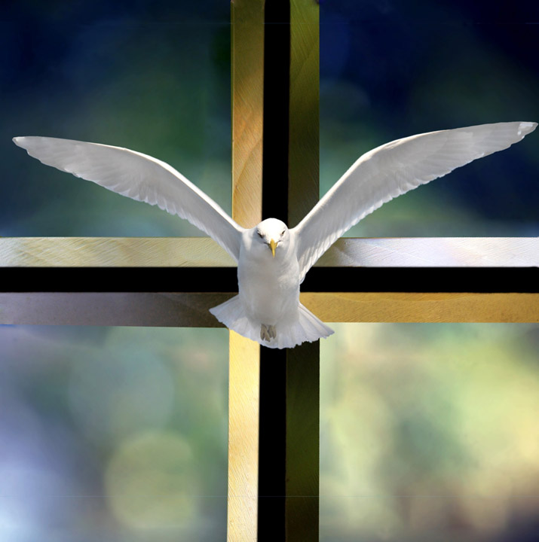
Listening to the Word of God
in the School of the Holy Spirit
Part 1
by Don Schwager
1

Slide 2
A Scriptural and Spiritual Approach
To Scripture Reading and Study
Part 1: Reading Scripture with the Holy Spirit
Part 2: Unity of Scripture – New hidden in the Old and Old unveiled in the New
Part 3: Formational Reading of Scripture
2

Slide 3
Part 1:
Reading Scripture with the Holy Spirit
“Did not our hearts burn within us while he talked to us on the road... while he opened to us the Scriptures”
– Luke 24:32
On the road to Emmaus Jesus helped his disciples to understand how the Old Testament Scriptures spoke about his mission as the Messiah who would suffer, die, and rise again to bring freedom and new life in the Spirit to all who believe in him.
4

Slide 4
Scripture Study: Listening to God’s Word
“These things I have spoken to you
while I am still with you. But the Helper, the Holy Spirit, whom the Father will send in my name, he will teach you all things and bring to your remembrance all that I have said to you.”
John 14:25
Jesus told his disciples that the Holy Spirit would be their teacher and constant guide.
5

Slide 5
“The word of God is living and powerful”
– Letter to the Hebrews 4:12
The Lord wants us to approach the Sacred Scriptures not simply as a word of the past but as God’s Word that is also addressed to us today. His word has power and wisdom that can transform and change us.
The Lord Jesus invites us to encounter him in the
daily reading of Sacred Scripture. Through the gift
and working of the Holy Spirit he opens our ears to hear his voice and to recognize his presence as he speaks to us through the words of Holy Scripture.
3

Slide 6
“Sacred Scripture is the speech of God as it
is put down in writing under the breadth of
the Holy Spirit.”
- Quote from Dei Verbum, 9
The Lord Jesus invites us to encounter him in the
daily reading of Sacred Scripture. Through the gift
and working of the Holy Spirit he opens our ears to hear his voice and to recognize his presence as he speaks to us through the words of Holy Scripture.
3

Slide 7
Saint Jerome, an early church father, wrote that to read Scripture is to converse with God
“You are reading [Scripture]? No. Your betrothed is talking to you. It is your betrothed, that is, Christ, who is united with you. He tears you away from the solitude of the desert and brings you into his home, saying to you, ‘Enter into the joy of your Master.’”
- Jerome (347-420 AD)
9

Slide 8
“How could one live without the knowledge of Scripture, through which one learns to know Christ himself, who is the life of the believer?”
- St. Jerome (347-420 AD)
8

Slide 9
“The Scriptures are in fact, in any passage you care to choose, singing of Christ, provided we have ears that are capable of picking out the tune.”
“The Lord opened the minds of the Apostles so that they understood the Scriptures. That he will open our minds too is our prayer.”
- St. Augustine of Hippo (354-430 AD)
9

Slide 10
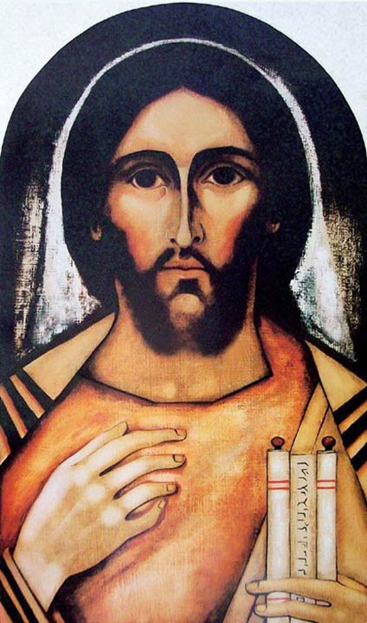
A Scriptural truth
Through the gift and
working of the Holy
Spirit, the Lord Jesus
continues to open
the Scriptures for us
as we listen and
reflect upon his word.
6

Slide 11
How can we read the Scriptures with the help and guidance of the Holy Spirit?
Fr. Raniero Cantalamessa writes:
“Reading the Scriptures without the Holy Spirit would be like opening a book in the dark”
- Quote from The Mystery of God’s Word
3

Slide 12
“Sacred Scripture is the speech of God as it is put down in writing under the breadth of the Holy Spirit.”
- Quote from Dei Verbum, 9
3

Slide 13
Learning to read Scripture spiritually
is a gift and work of the Holy Spirit.
Fr. Raniero Cantalamessa writes:
“Reading the Scriptures without the Holy Spirit would be like opening a book in the dark”
- Quote from The Mystery of God’s Word
3

Slide 14
How can we read the Scriptures with the
help and guidance of the Holy Spirit?
“Morning by morning he opens my ears to hear as those who are taught. The Lord God has opened my ear.” – Isaiah 50:4-5
8

Slide 15
Scripture Study: Listening to God’s Word
Hunger for God’s Word
The first step is to hunger for God’s word and to listen with a disciple’s ear. If we ask God to feed us, he will nourish and sustain us with the daily bread of his life-giving word.
Jesus answered, “One does not live by bread alone, but by every word that comes from the mouth of God” (Matthew 4:4).
7

Slide 16
Scripture Study: Listening to God’s Word
Listen with a
disciple’s ear
The Holy Spirit will give us a disciple’s ear if we are ready to listen and eager to learn.
“Morning by morning he wakens my ear to hear as those who are taught. The Lord God has opened my ear, and I was not rebellious” (Isaiah 50:4-5).
8

Slide 17
Scripture Study: Listening to God’s Word
Credits for Kairos Scripture Study Course
Illustrations by Kevin Carden, slides 1
Bible Illustrations by Sweet Media, slides 4-10, 16-18, 22, 29
Etching by Rembrandt, slide 24
Slides edited by Don Schwager

