Slide 1
Part 3:
Interpreting the Scriptures
Distinguishing the literal and spiritual
senses of Scripture

Slide 2
Interpreting the Scriptures
by Origen of Alexandria (185-254 AD)
"By what principle ought one to read and interpret the Scriptures?
It is a fact that a number of errors have had their origin in an inability to understand a sacred text in the right way.
…The reason for so many mistaken ideas about God consists solely in the inability to interpret Scripture in a spiritual sense.
It has been taken in its literal sense only.”

Slide 3
Scripture Study: Listening to God’s Word
The Two Meanings of the Bible by Origen
The reason why the divine power has given us the Scriptures is not solely to present facts according to the literal interpretation of the narrative. If one looks to the letter of the text, some of the facts have not actually happened and would be irrational and illogical.
By keeping the commandment of the Lord to search the Scriptures (John 5:39), one ought to examine with care and attention where the literal meaning is historical and where it is not.
In Scripture not everything is objectively historical in the literal sense. Sometimes it is obvious that the result of taking it literally is impossible. But the divine Scripture, taken as a whole, has a spiritual meaning.

Slide 4
Scripture Study: Listening to God’s Word
These words are the Word of God
Quote from Origen 185-254 AD
The Scriptures that prophesy about Christ, the words
that announce his coming and his teaching are inspired by God. They were proclaimed with power and authority and it is for this reason they have conquered so many people's hearts.
However, only with the coming of Christ have the divine character of the prophetic writings and the spiritual meaning of the books of the Mosaic Law become apparent. Before Christ it was not possible to produce decisive arguments for the inspiration of the Old Testament. The coming of Jesus persuaded even the doubtful that those pages were written under the influence of grace.

Slide 5
Scripture Study: Listening to God’s Word
Example of New Testament Interpretation
“They serve a copy and shadow of the heavenly sanctuary; for when Moses was about to erect the tent, he was instructed by God, saying, "See that you make everything according to the pattern which was shown you on the mountain.” – Hebrews 8:5
“For Christ has entered, not into a sanctuary made with hands, a copy of the true one, but into heaven itself, now to appear in the presence of God on our behalf. “ – Hebrews 9:24

Slide 6
Scripture Study: Listening to God’s Word
Example of New Testament Interpretation
“I want you to know, brethren, that our fathers were all under the cloud, and all passed through the sea, and all were baptized into Moses in the cloud and in the sea, and all ate the same supernatural food and all drank the same supernatural drink. For they drank from the supernatural Rock which followed them, and the Rock was Christ.”
– 1 Corinthians 10:1-4

Slide 7
Scripture Study: Listening to God’s Word
The Spiritual Interpretation of the Bible
Quotes from Raniero Cantalemessa
Biblical inspiration is the basis for much more than the... inerrancy of the Word of God; positively, it is the basis for its inexhaustibility, its divine force and vitality, and what St. Augustine called its mira projunditas, its marvellous depth.

Slide 8
Scripture Study: Listening to God’s Word
Cantalemessa quote, continued
Spiritual interpretation is objective; it is interpretation done under the guidance, or by the light, of the Holy Spirit, who inspired the Scriptures in the first place.
It is based on an historical event, that is, the redemptive act of Christ, who by his death and resurrection completes the plan of salvation, fulfils all types and prophecies, unveils all hidden mysteries, and offers us the true key for interpreting the whole Bible.

Slide 9
Scripture Study: Listening to God’s Word
Cantalamessa quote, continued
.
Anyone choosing to read the Scriptures after Christ's life while disregarding his act would be like someone persistently reading a musical score in the key of G when the composer has already moved into the key of B; every single note after the shift would sound false and out of tune.
The New Testament calls the new key "the Spirit," while it defines the old key as "the letter," saying that "the letter brings death, but the Spirit gives life" (2 Cor. 3:6).
Reading the Scriptures without the Holy Spirit would be like opening a book in the dark.

Slide 10
Scripture Study: Listening to God’s Word
Cantalamessa quote, continued
.
To erect an antithesis between "letter" and "Spirit" does not mean erecting one between Old and New Testaments, as though the former merely represented the letter and the latter only the Spirit.
It means, rather, to make an antithesis between the two different ways of reading either the Old Testament or the New: between the way which disregards Christ, and the way which, by contrast, evaluates everything by the light of Christ.
This is why the Church prizes both Testaments, for both speak to her of Christ.

Slide 11
Scripture Study: Listening to God’s Word
Examples of some Old Testament types
that foreshadow Christ and his role as
Priest, Prophet, and King
Abraham
Isaac
Melchizedek

Slide 12
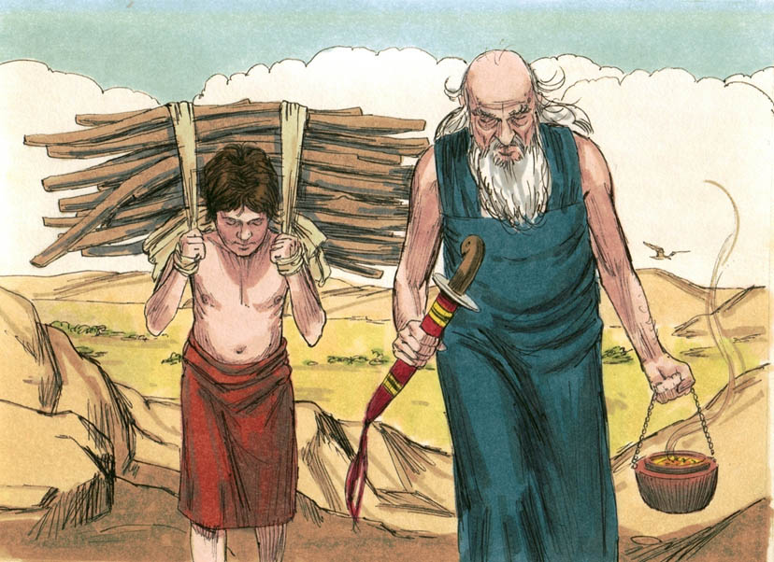
Scripture Study: Listening to God’s Word
And Abraham took the wood of the burnt offering and laid it on Isaac his son.

Slide 13
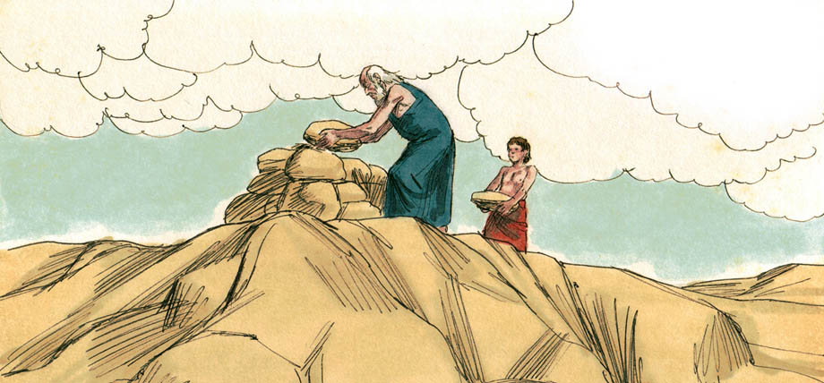
Scripture Study: Listening to God’s Word
⁷ And Isaac said to his father Abraham, “My father!” And he said, “Here I am, my son.” He said, “Behold, the fire and the wood, but where is the lamb for a burnt offering?” ⁸ Abraham said, “God will provide for himself the lamb for a burnt offering, my son.”

Slide 14
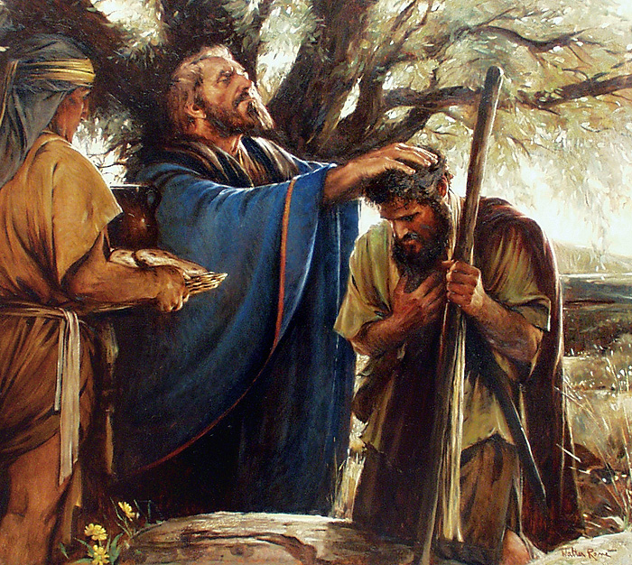
Scripture Study: Listening to God’s Word
Melchizedek was both priest and king without end
“A priest forever after the order of Melchizedek”
- Psalm 110:4

Slide 15
Scripture Study: Listening to God’s Word
Melchizedek
..
And Melchizedek king of Salem brought out bread and wine: and he was the priest of the most high God. And he blessed him, and said, "Blessed be Abram to the most high God, possessor of heaven and earth, And blessed be the most high God, who has delivered your enemies into your hand". And he gave him tithe from all.
— Genesis 14:18-20

Slide 16
Scripture Study: Listening to God’s Word
New Testament Interpretation
..
“Christ did not exalt himself to be made a high priest, but was appointed by him who said to him, “You are my Son, today I have begotten you";
as he says also in another place, “You are a priest for ever, after the order of Melchizedek."
- Hebrews 5:5,10

Slide 17
Scripture Study: Listening to God’s Word
Melchizedek and Jesus
Jesus is explicitly compared with Melchizedek in the New Testament (Genesis 14:18-20) because both held the position of Priest and King for eternity. (Hebrews 5-7; Genesis 14/ Psalm 110:4; Hebrews 5:6)
Melchizedek’s name means “King of Righteousness.” He ruled over “Salem” which means “peace.” He was the King of Peace. As a Priest, he was superior to the Aaronic priesthood of the Jews in the sense that even Abraham, (great-grandfather of Levi – Aaron and the priests of Israel all came from the tribe of Levi), paid tithes to Melchizedek. The Letter to the Hebrews makes the argument that even Aaron paid tithes to Melchizedek through Abraham.

Slide 18
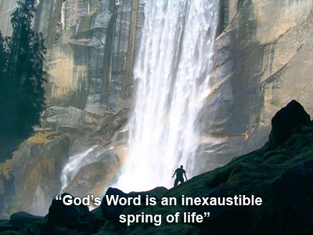
Scripture Study: Listening to God’s Word

Slide 19
Scripture Study: Listening to God’s Word
Credits for Kairos Scripture Study Course
Illustrations by Kevin Carden, slides 1, 7, 20
Bible Illustrations by Sweet Media, slides 12, 13
Slides edited by Don Schwager

